Slide 1

DarkWeb
Presented by
-Ananth

Slide 2
Contents
Introduction
History
What is Dark Web
How to access Dark Web
Applications
Advantages
Disadvantages
Conclusion
Reference

Slide 3
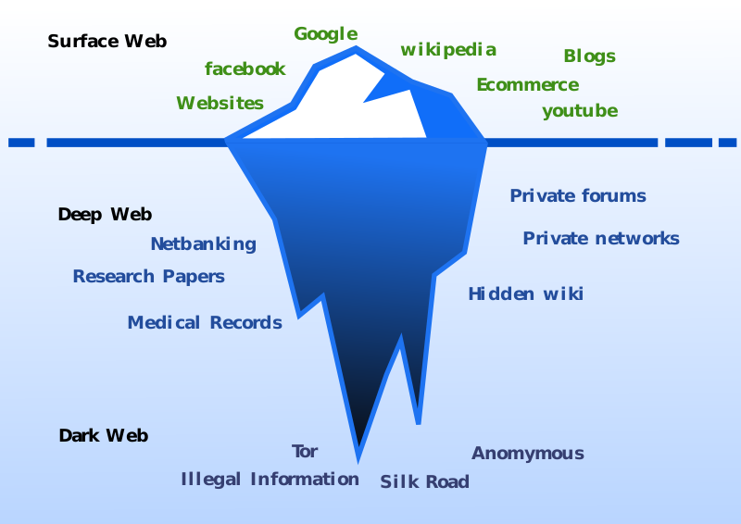
Introduction
If you are into computer security at all you may have heard of terms like “Deep Web” and “Dark Web”. The terms confusing that are : Surface Web, Deep Web, Dark Web.

Slide 4
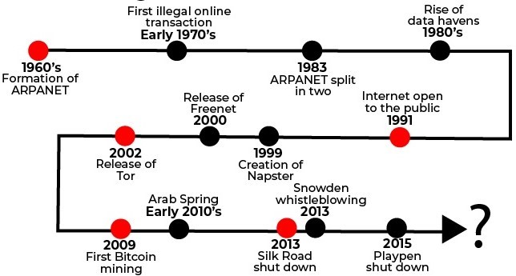
History
The ‘dark web’ is so called because it has been built to hide portions of the Internet from everyday users. A quick summary of the main events that culminated in the formation and development of the dark web.

Slide 5
What is DarkWeb
The dark web is the World Wide Web content that exists on dark nets, overlay networks that use the Internet but require specific software, configurations, or authorization to access. The dark web forms a small part of the deep web, the part of the Web not indexed by web search engines, although sometimes the term deep web is mistakenly used to refer specifically to the dark web.

Slide 6
How to access Dark Web
Install a VPN
VPN services are a must when you’re attempting to access the dark web. Why? Because of the long arm of the law.
2. Install an adequate browser
Download Tor
Tor over VPN
VPN over Tor
3. Install a VM or disposable OS
there are plenty of VMs to choose from: Oracle VM Virtual box, VMware Fusion and workstations, QEMU, Red Hat Virtualization, Microsoft Hyper-V, Citrix Xen Server and Xen Project, just to name a few.

Slide 7
Applications
Botnets
Bitcoin Services
Darknet Markets
Phishing and Scams
Fraud Services
Terrorism
Illegal Pornography
Social Media

Slide 8
Things You Can Buy
Drugs
Counterfeit Currency
Forged Papers
Firearms
Ammunition and Explosives
Hitmen
Human Organs

Slide 9
Things That Make Crime Work
Cryptocurrency
Bulletproof Web-hosting Services
Cloud Computing
Crime ware
Hackers for Hire
Multilingual Crime Call Centers

Slide 10
Advantages
Anonymity
Freedom of Speech
Political Activism
More Knowledge gain
Amazing individuals
You can publish & do anything
You can’t fear
Open banned websites also

Slide 11
Disadvantages
Hoaxes and unverified content
Phishing and scams
Illegal and ethically disputed pornography
Terrorism
Deep Web doesn’t work smoothly
Slow campare to our normal browsers
Hacking is fastly grown

Slide 12
Conclusion
The Dark Web networks such as TOR have provided many possibilities for malicious actors to exchange legal and illegal “goods” anonymously. Dark Web is a growing asset, especially in terms of the illicit services and activities. Security mechanisms should be vigilant to these problems and take measures to eliminate them. The evolving technology with encryption and anonymity has put law enforcement and policymakers in challenge to effectively struggle harmful actors who are operating in the cyberspace.

Slide 13
References
NPR Staff (25 May 2014). "Going Dark: The Internet Behind The Internet". Archived from the original on 27 May 2015. Retrieved 29 May 2015.
Greenberg, Andy (19 November 2014). "Hacker Lexicon: What Is the dark web?". Wired. Archived from the original on 7 June 2015. Retrieved 6 June 2015.
"Clearing Up Confusion – Deep Web vs. dark web". BrightPlanet. 201403-27. Archived from the original on 2015-05-16.

Slide 14
Thank You…

